Slide 1


Average Time on Page, across multiple industries
Average Time on B2B websites and special interest Portals

Slide 3
EAC REGIONAL HEALTH PORTAL
MODALITIES AND ROADMAP OF TRANSFERRING SCATTERED EAC HEALTH CONTENT AND APPLICATIONS
Presented by:
Aileen Mallya
Web Editor,
EAC Secretariat

Slide 6
Why an EAC Regional Health Portal?
A simple definition of a Web Portal
A web portal is a web-based platform that collects information from different sources into a single user interface and presents users with the most relevant information for their context.
Over time, simple websites have evolved into portal platforms that support digital customer experience initiatives.
Notes:
A web portal is a specially designed website that often serves as the single point of access for information. It can also be considered a library of personalized and categorized content. A web portal helps in search navigation, personalization, notification and information integration, and often provides features like task management, collaboration, and business intelligence and application integration.

Slide 7




Why an EAC Regional Health Portal?
Characteristics of Web Portals
Web portals are websites that collect information on the same topic;
Web portals provide a single point of entry of access to a variety of contents, services and applications;
Web portals maybe be based on a specific function or interest area;
Web portals provide advantage over homepages as they can offer user specific, customized views.

Slide 8
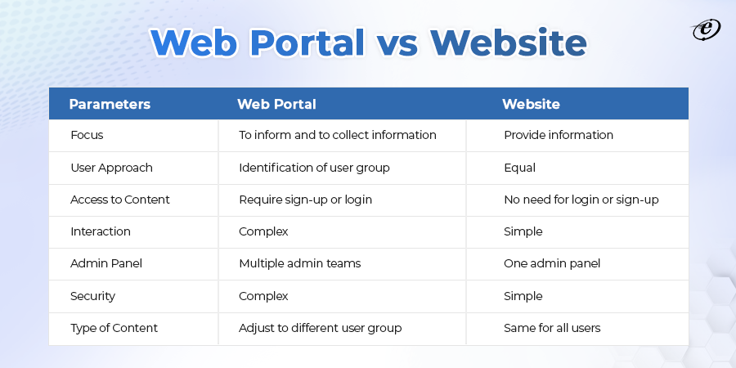
Notes:
A web portal is a specially designed website that often serves as the single point of access for information. It can also be considered a library of personalized and categorized content. A web portal helps in search navigation, personalization, notification and information integration, and often provides features like task management, collaboration, and business intelligence and application integration.

Slide 9
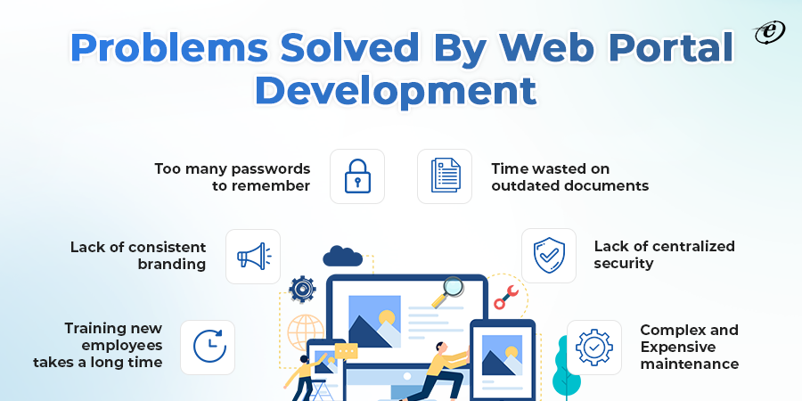
Notes:
A web portal is a specially designed website that often serves as the single point of access for information. It can also be considered a library of personalized and categorized content. A web portal helps in search navigation, personalization, notification and information integration, and often provides features like task management, collaboration, and business intelligence and application integration.

Slide 10
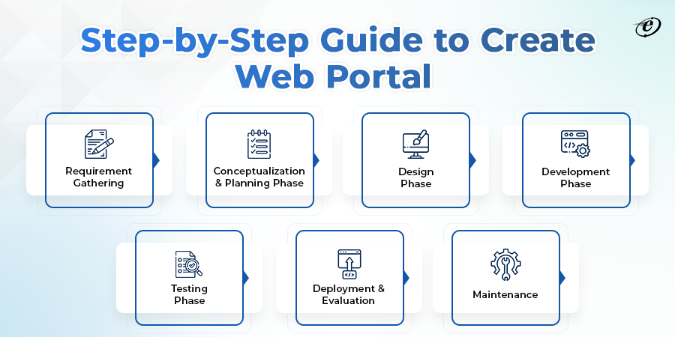
Notes:
A web portal is a specially designed website that often serves as the single point of access for information. It can also be considered a library of personalized and categorized content. A web portal helps in search navigation, personalization, notification and information integration, and often provides features like task management, collaboration, and business intelligence and application integration.

Slide 11
1: REQUIREMENTS GATHERING
1a: Internal Requirements
1b: Stakeholder Requirements
Identify all our internal information assets (content, systems, applications, tools etc)
Where are these information assets located?
What are the current and projected requirements for centralized hosting of these information assets?
Who is our target audience and what is the objective of this portal?
What are the user requirements of our key users?
What other resources can we incorporate to better serve our users? Collaboration tools? Special interest forums? Online training programmes?
Clear identification of Project scope
Notes:
A web portal is a specially designed website that often serves as the single point of access for information. It can also be considered a library of personalized and categorized content. A web portal helps in search navigation, personalization, notification and information integration, and often provides features like task management, collaboration, and business intelligence and application integration.

Slide 12
EAC Health Information Assets/Resources
health.eac.int
eac.int/health
eac.int/mrh
eac.int/mobilelabs
https://www.eahealth.org/
https://www.eac.int/health/eahrj & https://www.eac.int/health/easci (Journals)
eacpass.eac.int
rcc.eac.int
Online tools:
  mrh.eac.int
  Eacpass.eac.int
  Covidcheck.eac.int
  Healthdata.eac.int
  …..
Notes:
A web portal is a specially designed website that often serves as the single point of access for information. It can also be considered a library of personalized and categorized content. A web portal helps in search navigation, personalization, notification and information integration, and often provides features like task management, collaboration, and business intelligence and application integration.

Slide 13
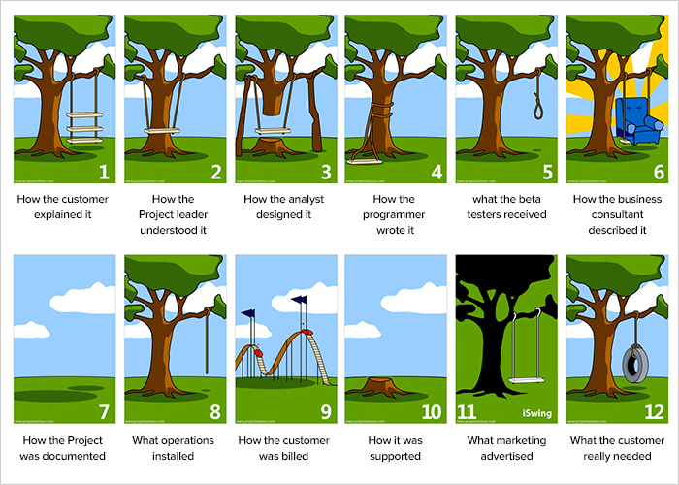

Slide 14
2: CONCEPTUALIZATION & PLANNING
Project Scope of work
Tech Stack identification - programming languages, frameworks, a database, front-end tools, back-end tools, and applications connected via APIs, hosting environment etc
Identification of Tasks and iterations
Budget
Timelines
Notes:
A web portal is a specially designed website that often serves as the single point of access for information. It can also be considered a library of personalized and categorized content. A web portal helps in search navigation, personalization, notification and information integration, and often provides features like task management, collaboration, and business intelligence and application integration.

Slide 15

3: DESIGN
Architecture (including hierarchy and connection)
User Interface (UI) and User Experience (UX)
Web Portal “Real Estate” utilization.
Wireframes
Prototype
Notes:
A web portal is a specially designed website that often serves as the single point of access for information. It can also be considered a library of personalized and categorized content. A web portal helps in search navigation, personalization, notification and information integration, and often provides features like task management, collaboration, and business intelligence and application integration.

Slide 16
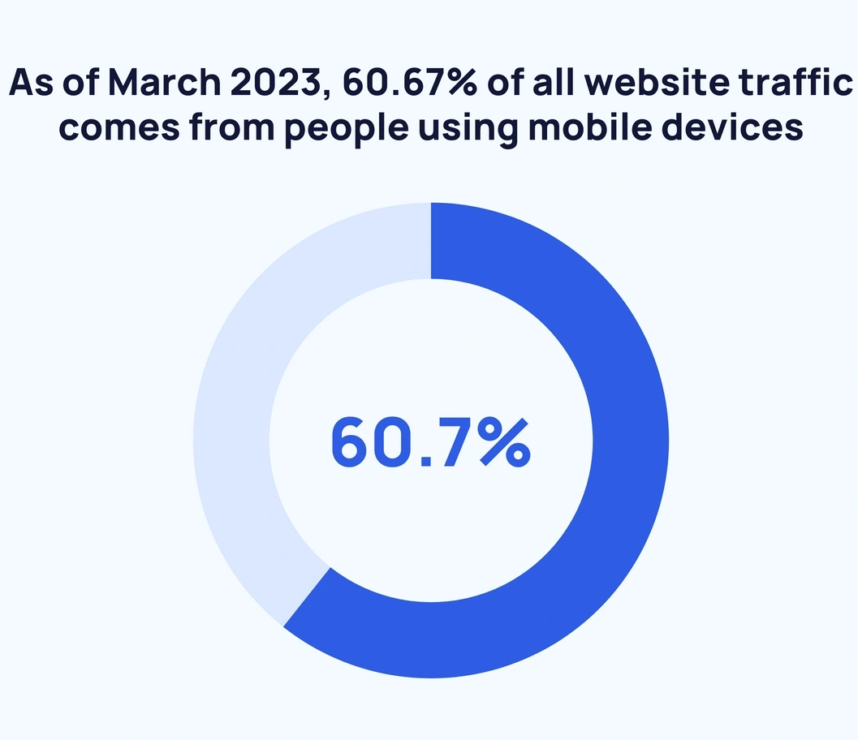
60.67% of website traffic comes from mobile devices.
92.3% of internet users access the internet using a mobile phone.
There are approximately 4.32 billion active mobile internet users.
Africa has the highest proportion of internet traffic from mobile devices - 69.13%.
Notes:
A web portal is a specially designed website that often serves as the single point of access for information. It can also be considered a library of personalized and categorized content. A web portal helps in search navigation, personalization, notification and information integration, and often provides features like task management, collaboration, and business intelligence and application integration.

Slide 17
4: DEVELOPMENT
4a: Development
4b: Integration
Front-end and Back-end
Databases
Real-time data processing
Content Management System
Mobile platforms etc
Connecting all tools and information assets:
APIs
Customs Software
SaaS etc
Notes:
A web portal is a specially designed website that often serves as the single point of access for information. It can also be considered a library of personalized and categorized content. A web portal helps in search navigation, personalization, notification and information integration, and often provides features like task management, collaboration, and business intelligence and application integration.

Slide 18
5: STAGING & TESTING
Experienced Developer and ICT partitioners test the portal to catch any errors, missed requirements and instability issues including issues such as navigation, performance, speed, etc.,
6: DEPLOYMENT & EVALUATION
Deployment is real-time running.
Continuous monitoring of performance for load balance.
Notes:
A web portal is a specially designed website that often serves as the single point of access for information. It can also be considered a library of personalized and categorized content. A web portal helps in search navigation, personalization, notification and information integration, and often provides features like task management, collaboration, and business intelligence and application integration.

Slide 19

7: MAINTENANCE & SUSTAINABILITY
Constant maintenance and periodic updates are required to keep the portal relevant and worth visiting.
Portal maintenance is necessary to ensure it is up-to-date and running smoothly as well as performing optimally.
Need to Develop an EAC Regional Health Portal Sustainability Plan (including required resources)
Notes:
A web portal is a specially designed website that often serves as the single point of access for information. It can also be considered a library of personalized and categorized content. A web portal helps in search navigation, personalization, notification and information integration, and often provides features like task management, collaboration, and business intelligence and application integration.

Slide 20
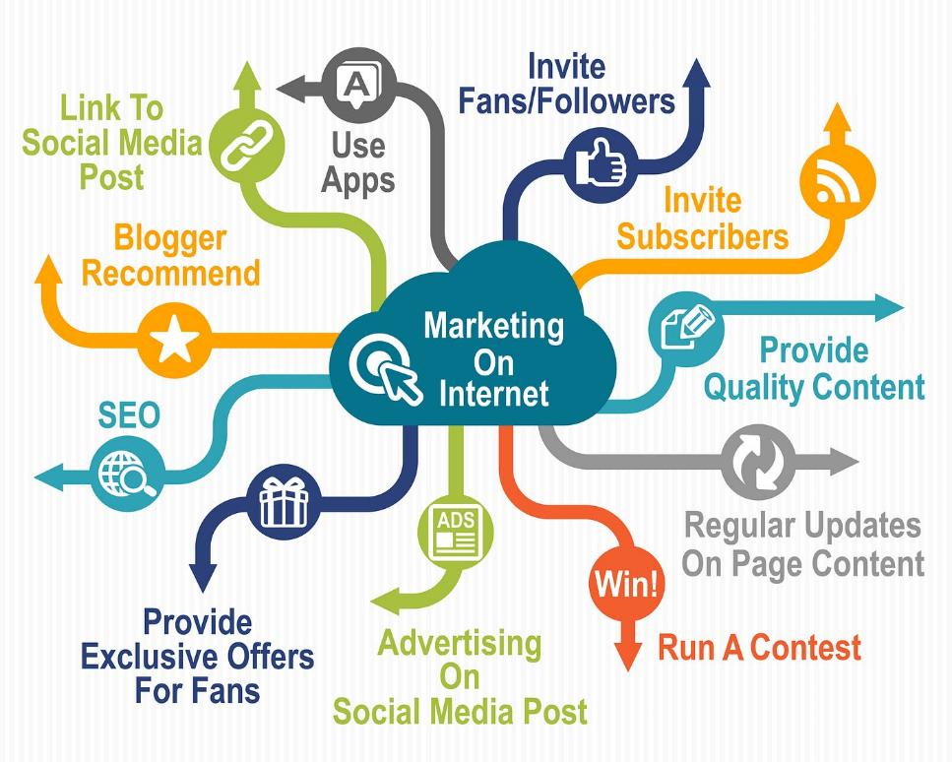
EAC Regional Health Portal
Portal Marketing
Portal marketing is the process of promoting your web portal on the Internet and offline.
The main goal of a web portal marketing is to get more visits to the portal.
Need to Develop an EAC Regional Health Portal Marketing Strategy
Notes:
A web portal is a specially designed website that often serves as the single point of access for information. It can also be considered a library of personalized and categorized content. A web portal helps in search navigation, personalization, notification and information integration, and often provides features like task management, collaboration, and business intelligence and application integration.

Slide 21
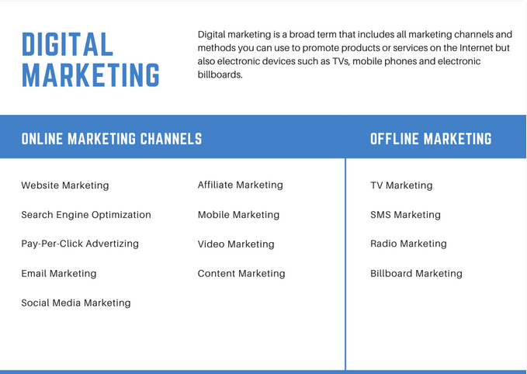

Slide 22
Strengthening EAC Regional Health Portal
Roadmap
Time Frame | Activity
April – May 2023 | Consolidate existing scattered health information assets to the EAC Health Portal
May 2023 | Integrate content from LHSS in the EAC Health Portal
 | Develop and rollout Digital Marketing Plan Objective is to enhance popularity of the portal and establish it a the region’s one stop center for matters Health.
June 2023 | Develop Portal Maintenance and Sustainability Plan Objective is to ensure sustainability of Software, Hardware, Content. Identify responsibility centers.
Notes:
A web portal is a specially designed website that often serves as the single point of access for information. It can also be considered a library of personalized and categorized content. A web portal helps in search navigation, personalization, notification and information integration, and often provides features like task management, collaboration, and business intelligence and application integration.

Slide 23
Do you have any Questions?

