Slide 1

A Digital Health Solution for the the Local Health System Sustainability Project
(CB-DHS)
Prepared by
IntelliSOFT Consulting Ltd
One Padmore Place, George Padmore Road, Nairobi, Kenya

Slide 2


IntelliSOFT Consulting Limited
A Kenyan ICT firm founded in 2008.
Currently focused on; Development, Implementation and enabling Healthcare Workers MEANINGFULLY use Digital Health Solutions in the health sector.
Supports entire digital health spectrum from Research & Innovation, Implementation to development of Digital Health Policies
Health Research Support information Systems
Health Management Information Systems.
About Us
We have footprints across Africa including; Kenya, Uganda, Tanzania South Sudan, Zambia, Sierra Leone, Rwanda, Ethiopia, Mozambique & Zimbabwe.

Slide 3
CB-DHS
IntelliSOFT has been contractually engaged to enhance the Cross Border Digital Health Solution to improve and digitize cross-border health information systems in cross border areas.
Through the Local Health System Sustainability Project (LHSS) East Africa country Activity, USAID will also:
Increase capacity of regional organizations to lead the development and implementation of cross-border programs and policies.
Strengthen regional and national financing, resource mobilization, and accountability for cross-border health.
Overview

Slide 4
WHY DIGITAL HEALTH? WHAT IS THE VALUE OF DIGITAL HEALTH FOR THE EAC?
WHAT IS THE VALUE OF DIGITAL HEALTH?

Slide 5
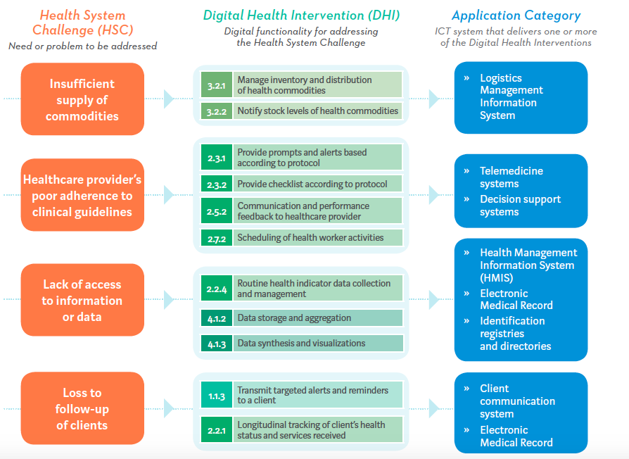

Slide 8









Approach to CB-DHS Design & Development
Design With the User
Understand the Existing Ecosystem
Design For Scale
Build for Sustainability
Be Data Driven
Open Standards, Data, Open Source & Innovation
Reuse and Improve
Address Privacy & Security
Be Collaborative

Slide 9
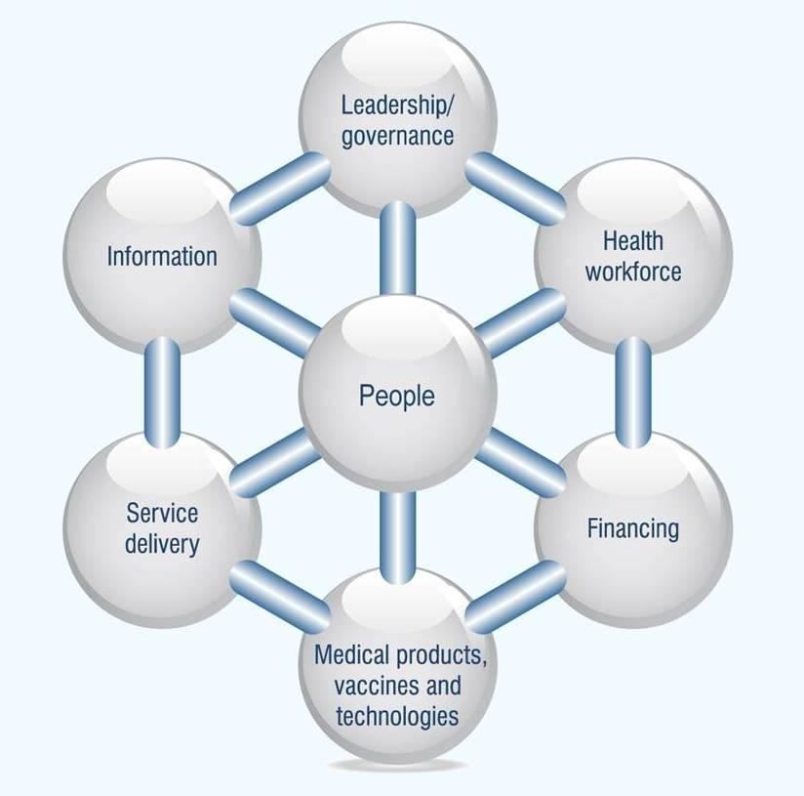

Health Systems Strengthening
Digital Health

Slide 10
The Cross Border Digital Health Solution (CB-DHS)

Slide 11
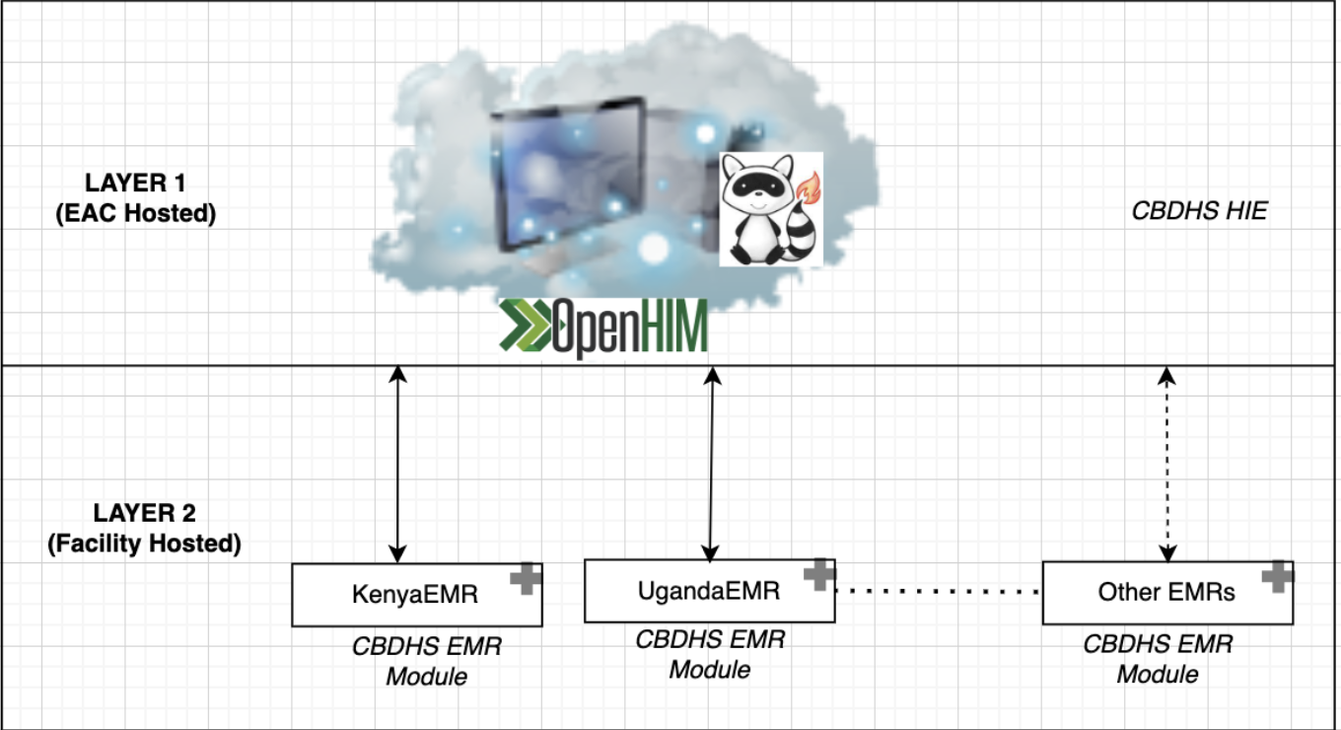
CB-DHS
High level architecture
Notes:
The Interoperability Layer: This layer contains services that will be responsible for facilitating the exchange of data between the different Health Information Exchange component systems.
Shared Health Record. This component will be responsible for keeping a central data repository of patient clinical records derived from the Health Management Information Systems.
Health Management Information System: This component will store routinely-collected aggregate healthcare data and facilitate their analysis
Client registry: This component will be responsible for maintaining an accurate and efficient unique identification of patients.
Terminology Services Registry: This component provides a centralized source for the HIE’s standards and definitions, including terminologies, ontologies, dictionaries, code systems, and value sets. Other components can use these standards and definitions to normalize clinical data and achieve consistent aggregation and reporting.
Health Facilities Registry: This component will be responsible for storing and distributing and up to date and standardized set of facility data.
Point of service: This component will consist of several systems that will be used by healthcare workers to update patient information and record healthcare transactions either at the community or facility level.

Slide 12
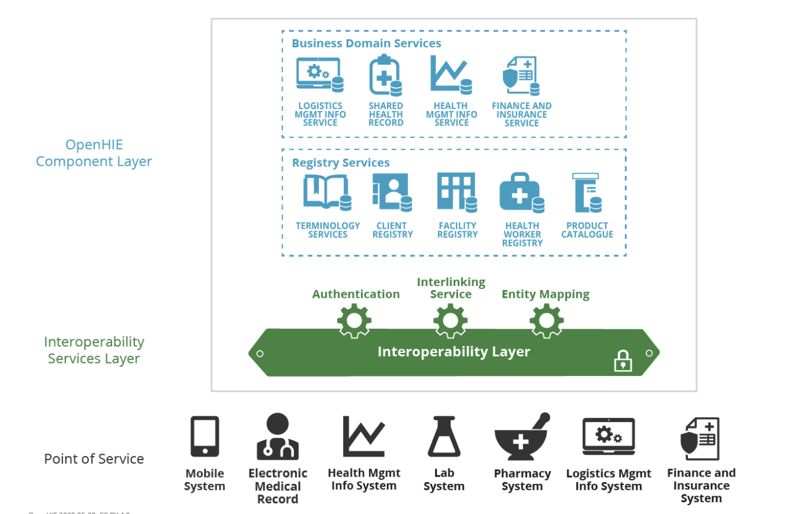
Modeling

Slide 13
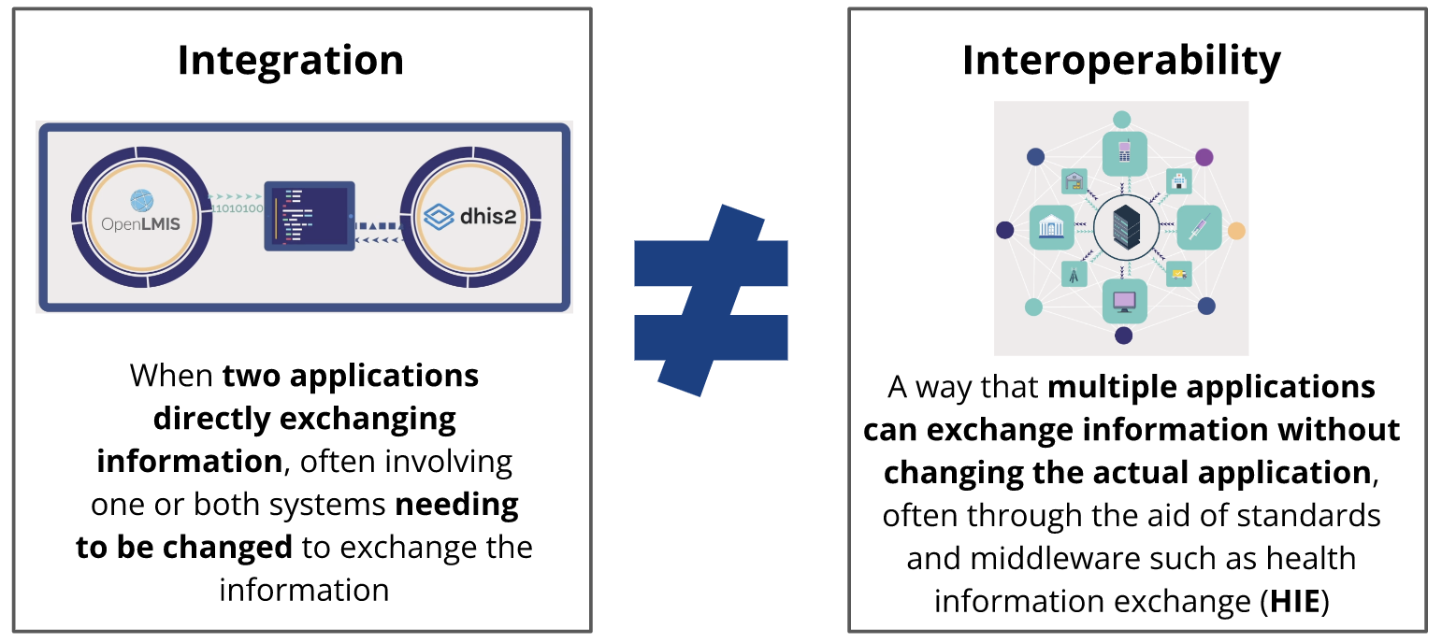
CB-DHS implements INTEROPERABILITY BY DEFAULT

Slide 14
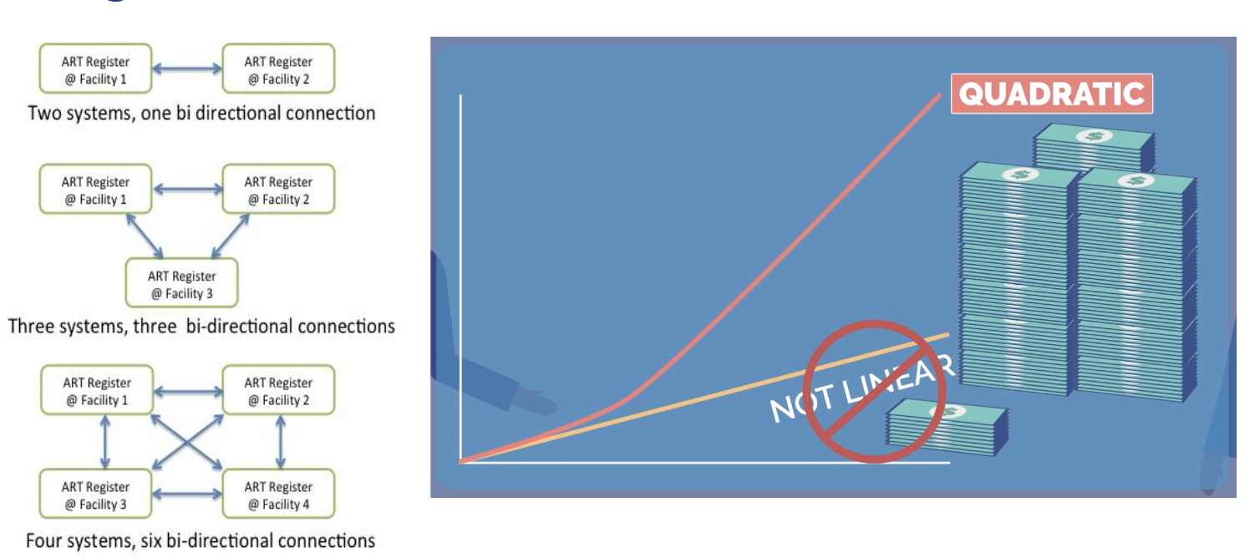
Why?

Slide 15
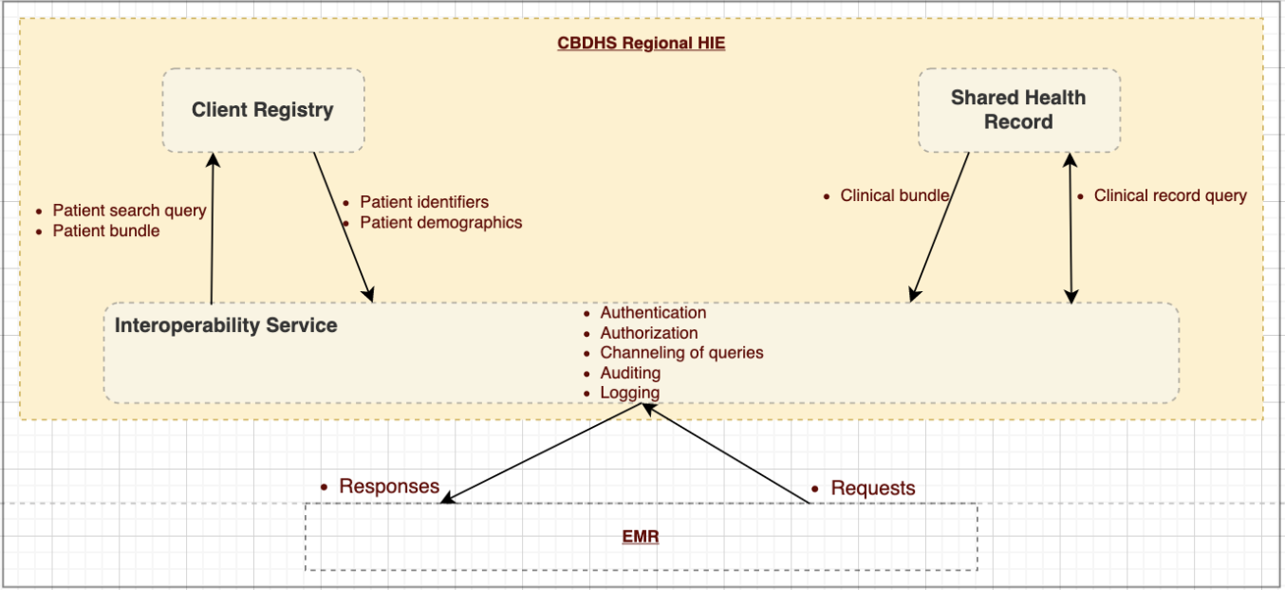
CB-DHS Regional HIE

Slide 16
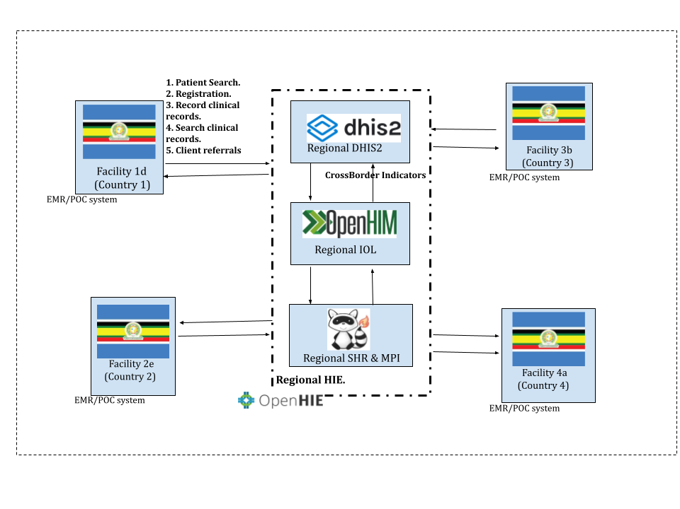
CB-DHS
Regional HIE
NB: Open Health Information Mediator (OpenHIM) is the interoperability layer of the initiative
Notes:
OpenHIM is the interoperability layer of the initiative

Slide 17
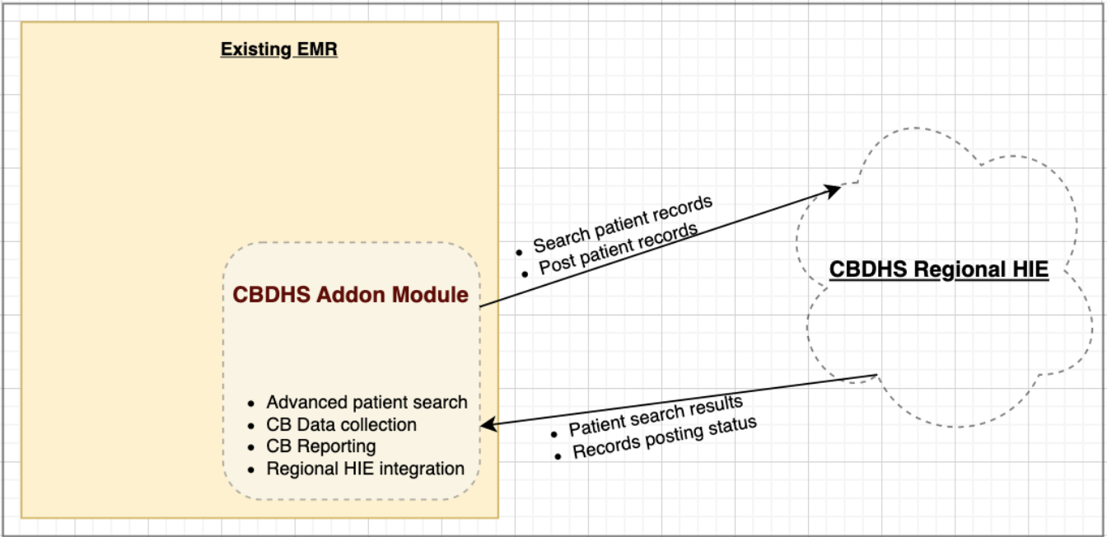
CB-DHS Utility Module

Slide 18
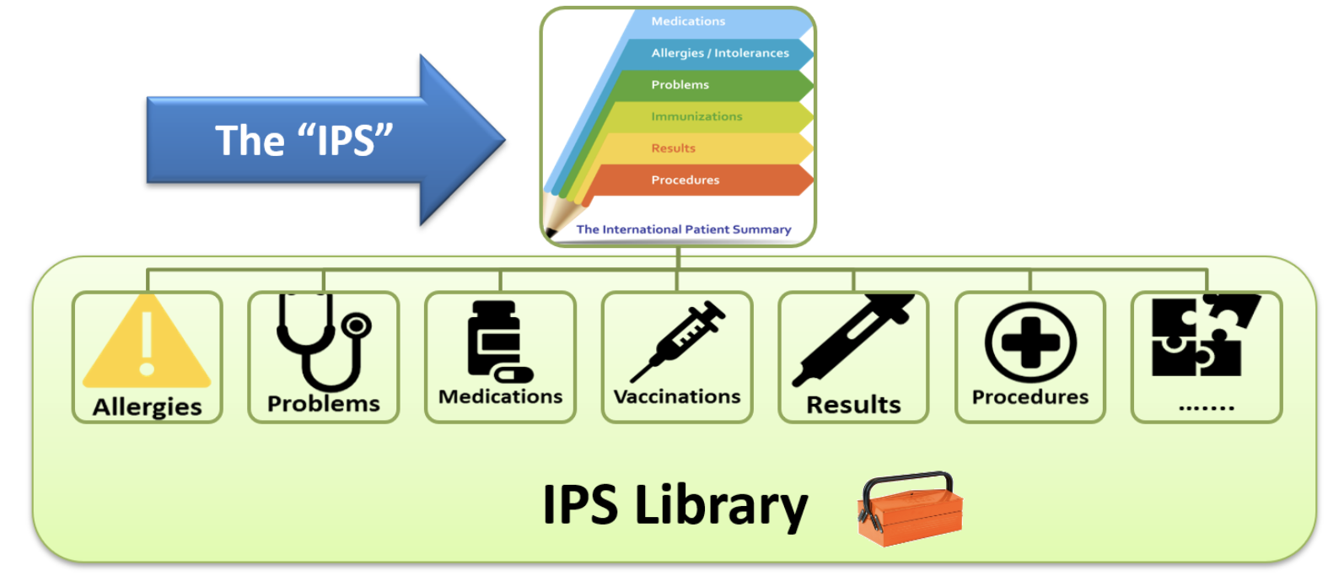
The Central Focus…Person centered health care…

Slide 19
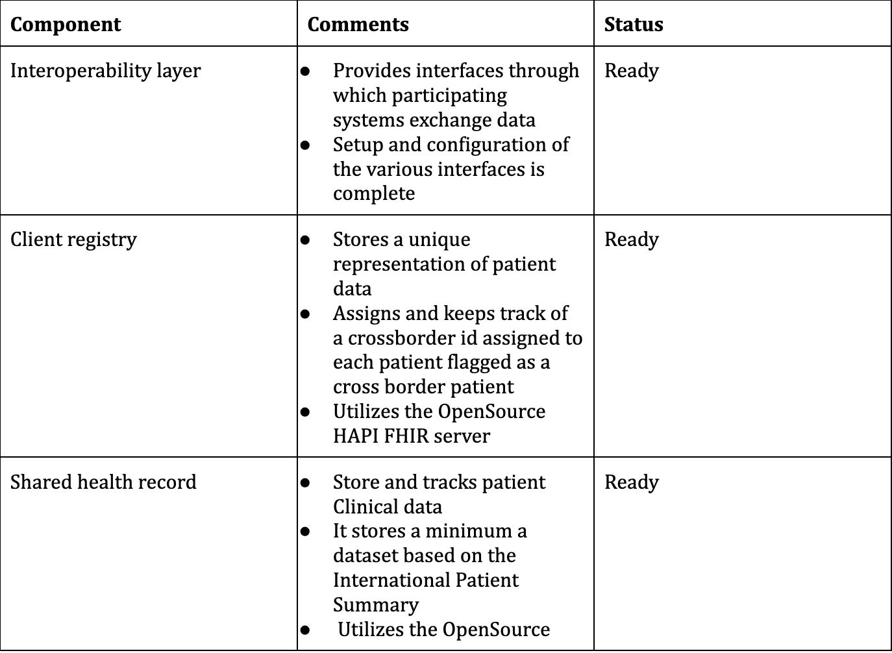
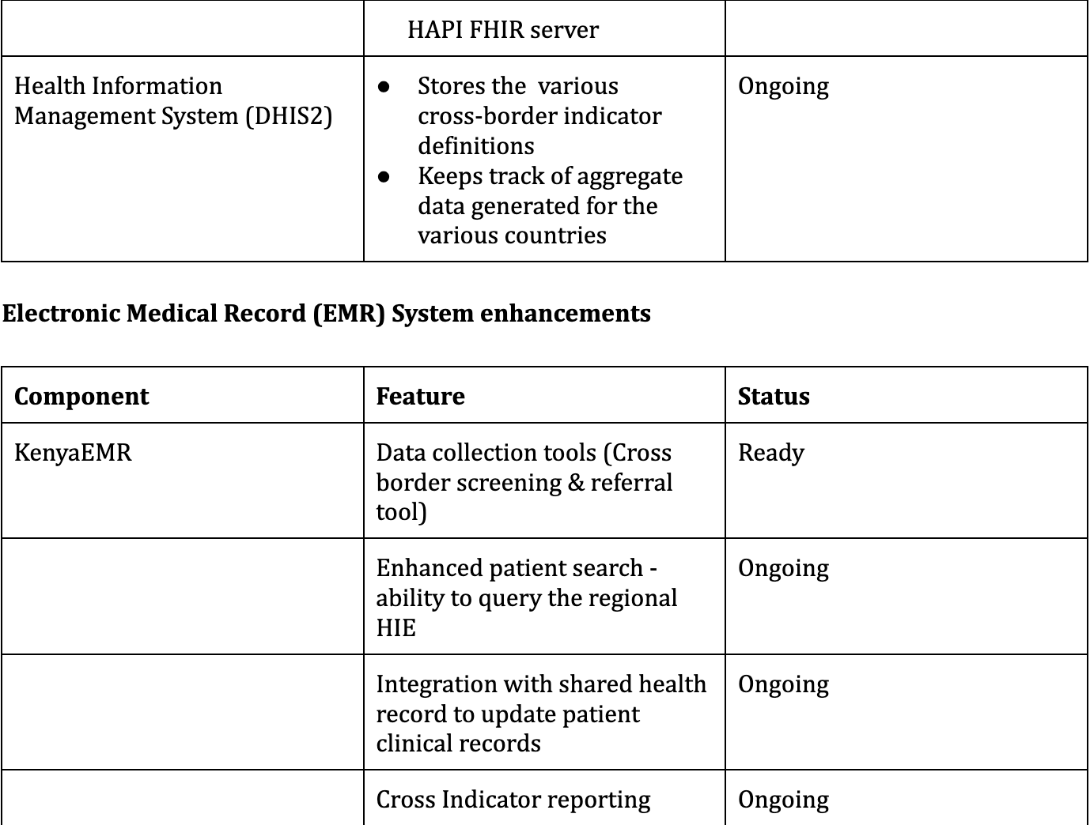
Overall Status

Slide 20
Thank You
Any Questions?
Prepared by
IntelliSOFT Consulting Ltd
One Padmore Place, George Padmore Road, Nairobi, Kenya
info@intellisoftkenya.com | www.intellisoftkenya.com | +254 711 466 263

